Slide 1
Random Forest in Python
Data sets: bankloan.csv and petrol_consumption.csv

Slide 2
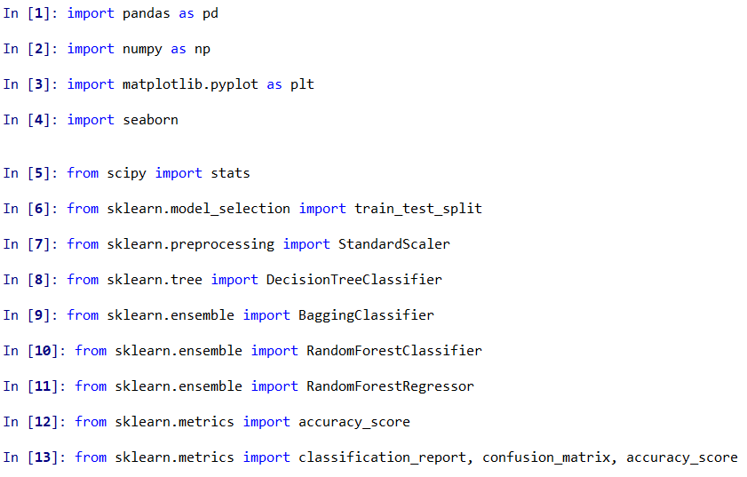
Import packages

Slide 3
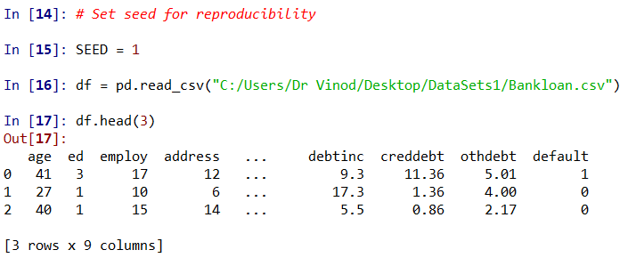
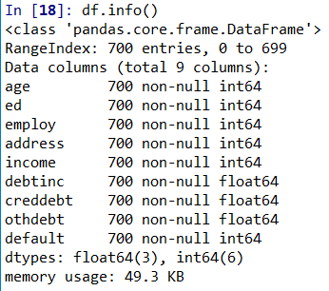
Import Data

Slide 4
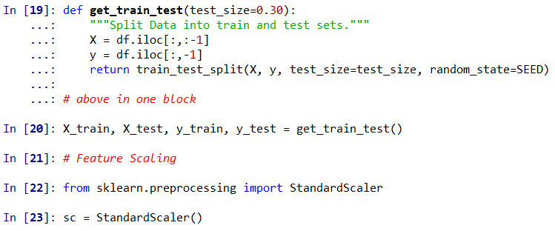
Train and Test data

Slide 5
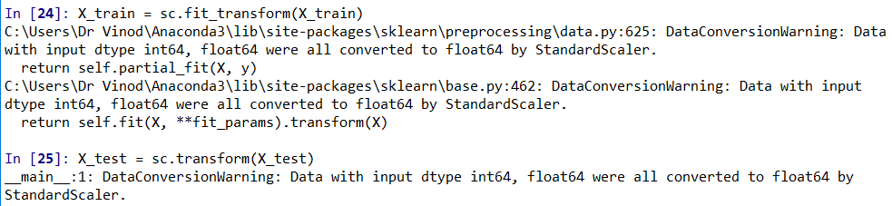
Scale Training & Test data set of predictors

Slide 6
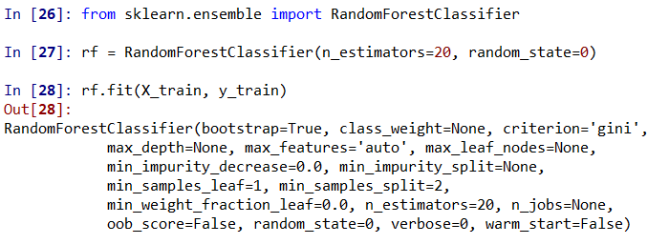
Build model
In random forest only a subset of predictors are considered for splitting, sqrt(n_predictors)

Slide 7
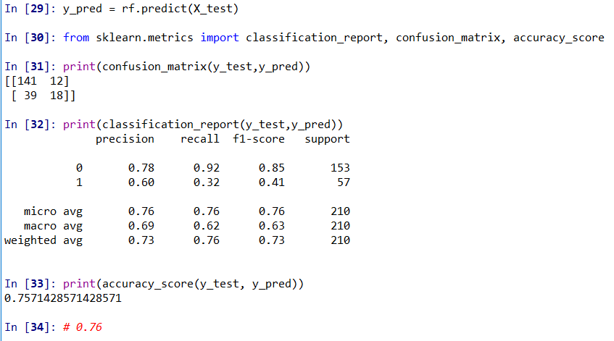
Classification Matrix and other metrics

Slide 8
Random Forest: Prediction

Slide 9
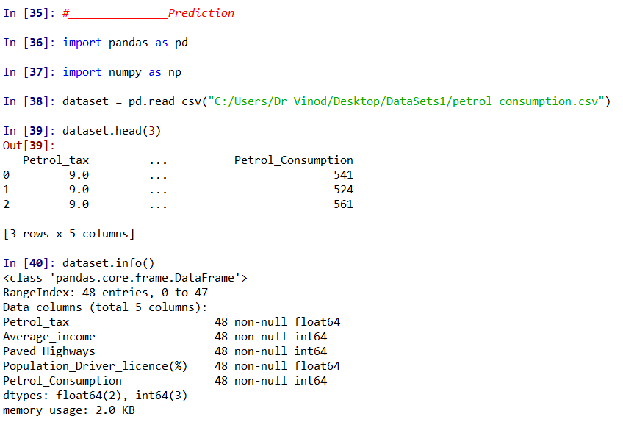

Slide 10
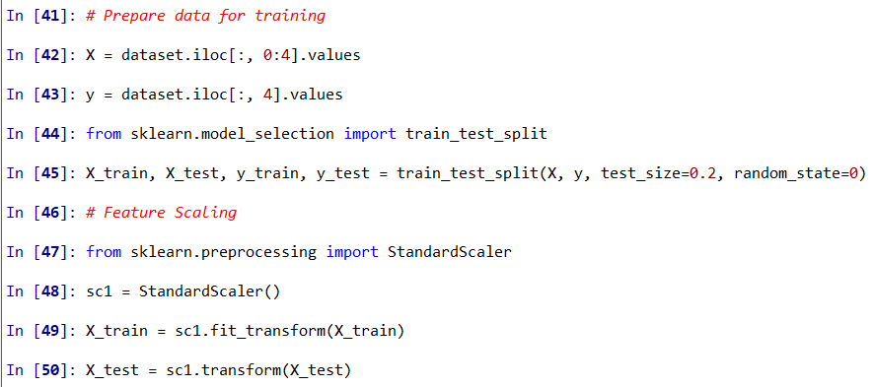
Training, Testing data and scaling

Slide 11
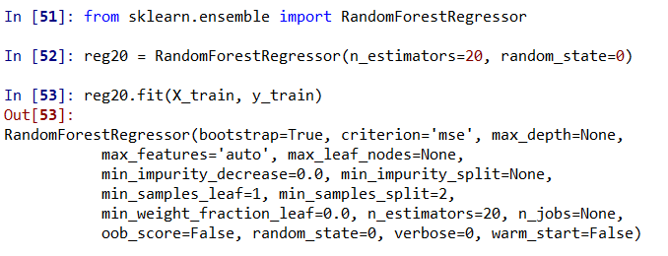
Build Model

Slide 12
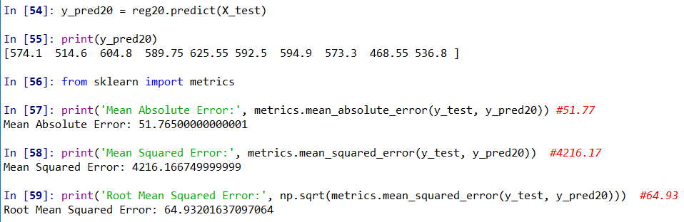
Predict and check accuracy

Slide 13
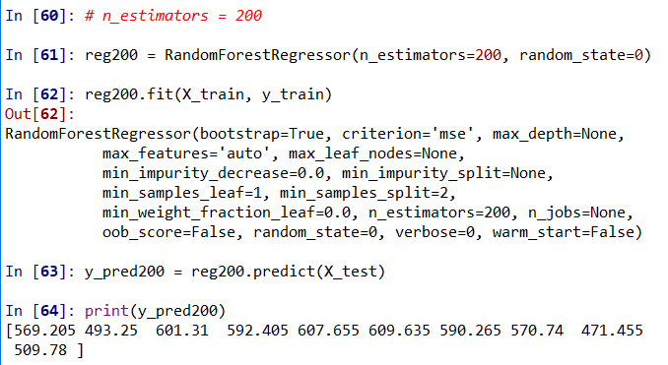
Build another model

Slide 14
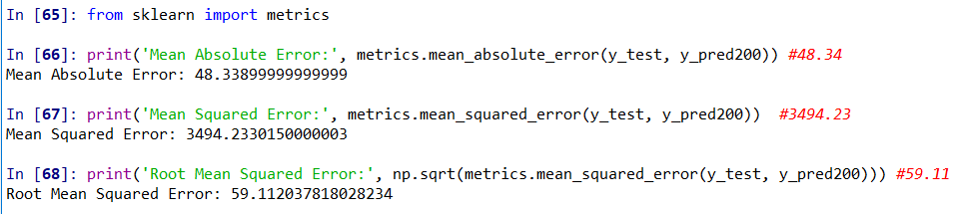
Check accuracy

Slide 15
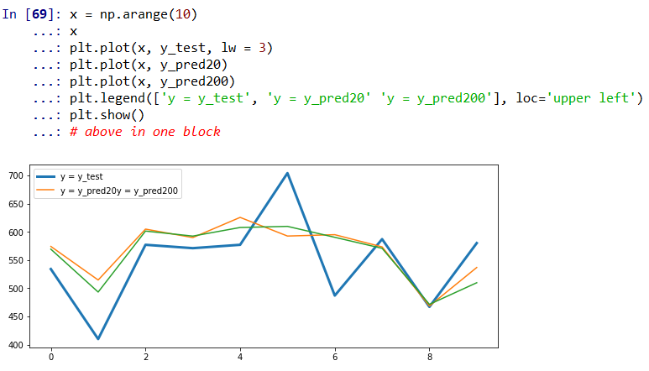
Lets see in line diagram

Slide 16
Enjoy Learning!

